Slide 1

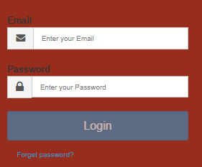
RiskPal Beta Site
Not just another travel management platform.
RiskPal is different, putting risk assessment at the heart of travel management and duty of care.
For more information please contact info@hpriskmanagement.com

